Slide 1
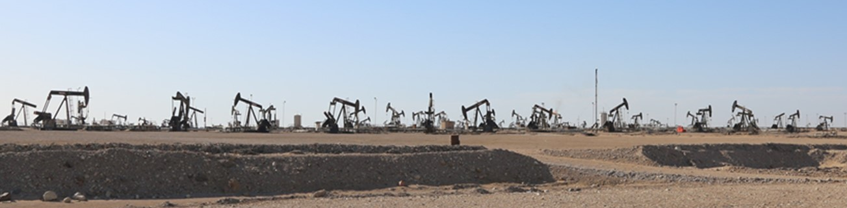
Themes of Carbonate Oil field Complexity
Issaran Field November 2021
12API, 1000-3000cP dual porosity fractured carbonate; Steam-EOR
High well density and high data density

Slide 2
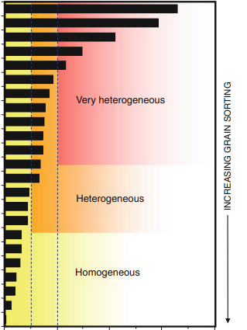
Carbonate reservoirs are in general more complex than sandstone reservoirs
Dual porosity
Carbonates
Issaran
Tidal
Clastics
Shallow
Marine
Clastics
Aeolian
Clastics
Heterogeneity

Slide 3
Dual Porosity Behaviour at field scale: Qarn Alam Oilfield, PDO Oman
From: Penney et all 2007
SPE 105406
the oil contained in the highly permeable fracture network was produced and replaced mostly by formation water
Same is true for the Nukhul in Iss

Slide 4
Resolving Carbonate Reservoir Complexity – Issaran Identified Themes
To tackle this complexity, a structured and theme-based approach is required
Reservoir properties are dependent on primary depositional factors and secondary diagenetic processes
The depositional Environment
Flow Unit identification
Understanding Diagenetic processes
Petrophysical Complexity
Fracture Modelling
New Technology implementation
Significant niche expertise is essential

Slide 5
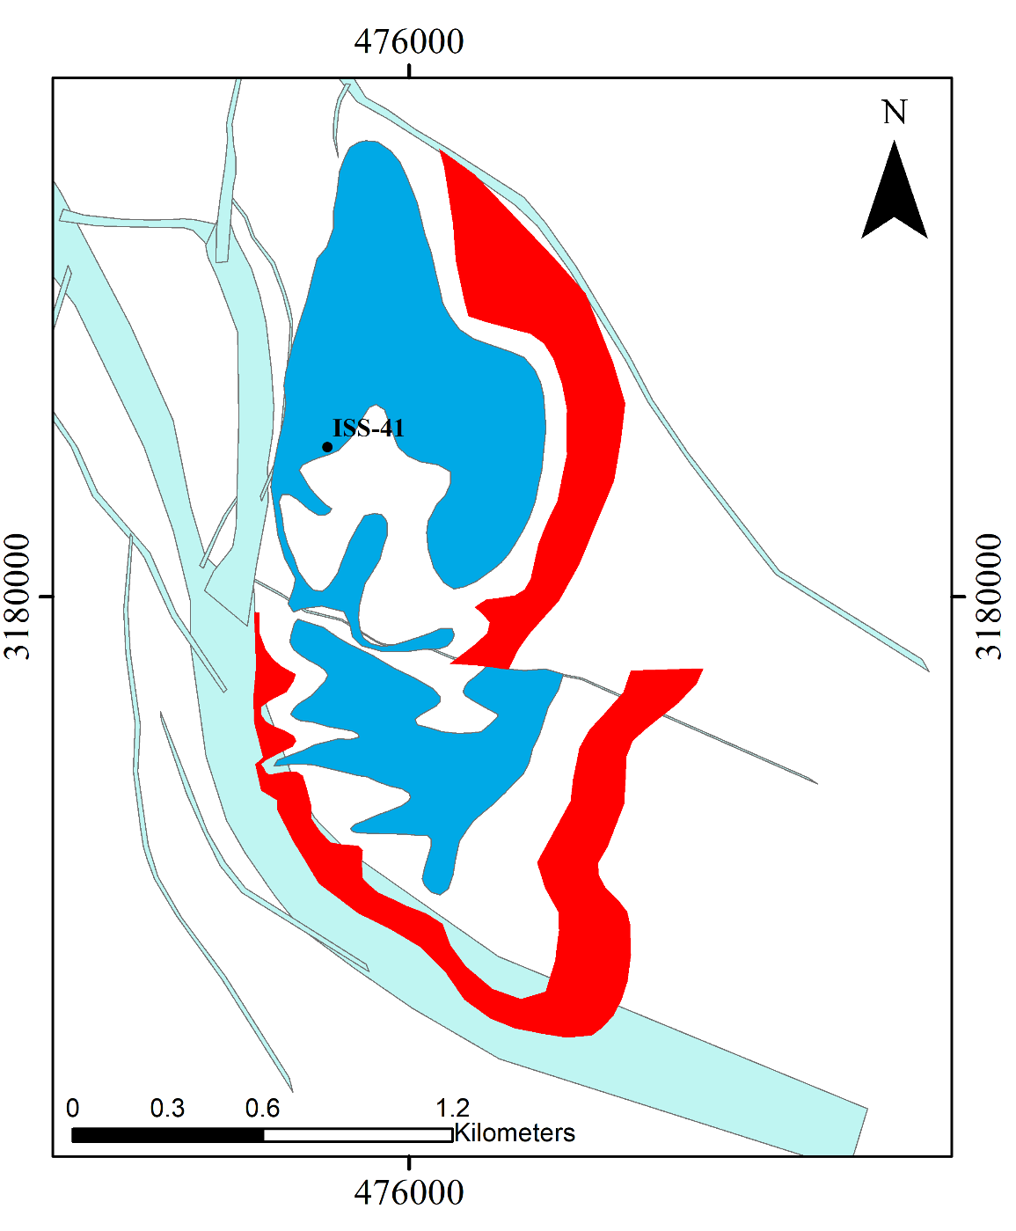
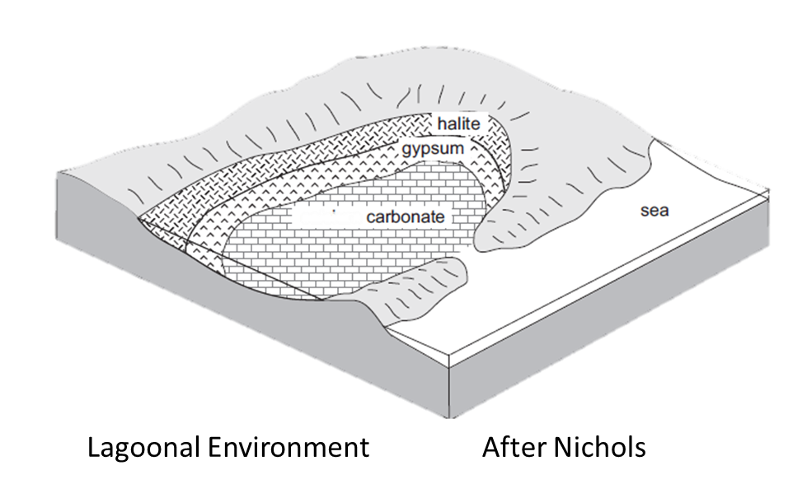
Issaran Identified Themes – Depositional and Facies Heterogeneity
in carbonate reservoirs, original depositional architecture can be key in the prediction of petrophysical properties.
High Anhydrite Percentage (>60%)
Low Anhydrite Percentage (<20%)
Anhydrite Probability based on 100 wells; 1 by 3 km

Slide 6
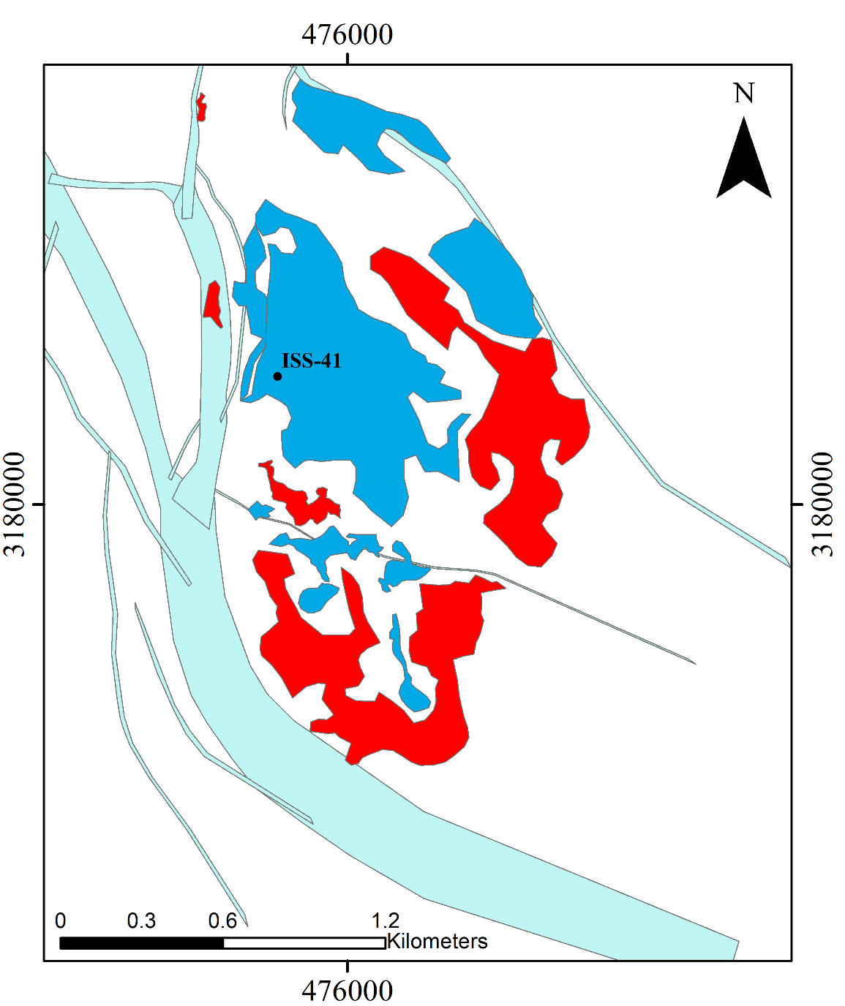
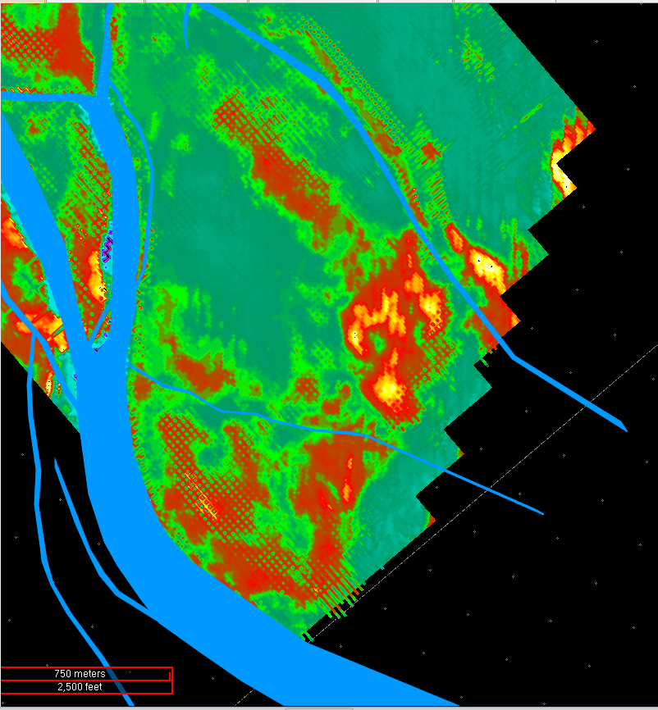
Issaran Identified Themes – Depositional and Facies Heterogeneity
Geological Model
Facies distribution extracted from inverted seismic data Model
Inverted Seismic Data
ISS-41
High Anhydrite Percentage (>60%)
High Anhydrite Probability
Low Anhydrite Percentage (<20%)
Low Anhydrite Probability
Broad similarity provides predictive power; I-233
2020 reprocessing by WesternGeco
Also inversion done in 2021

Slide 7
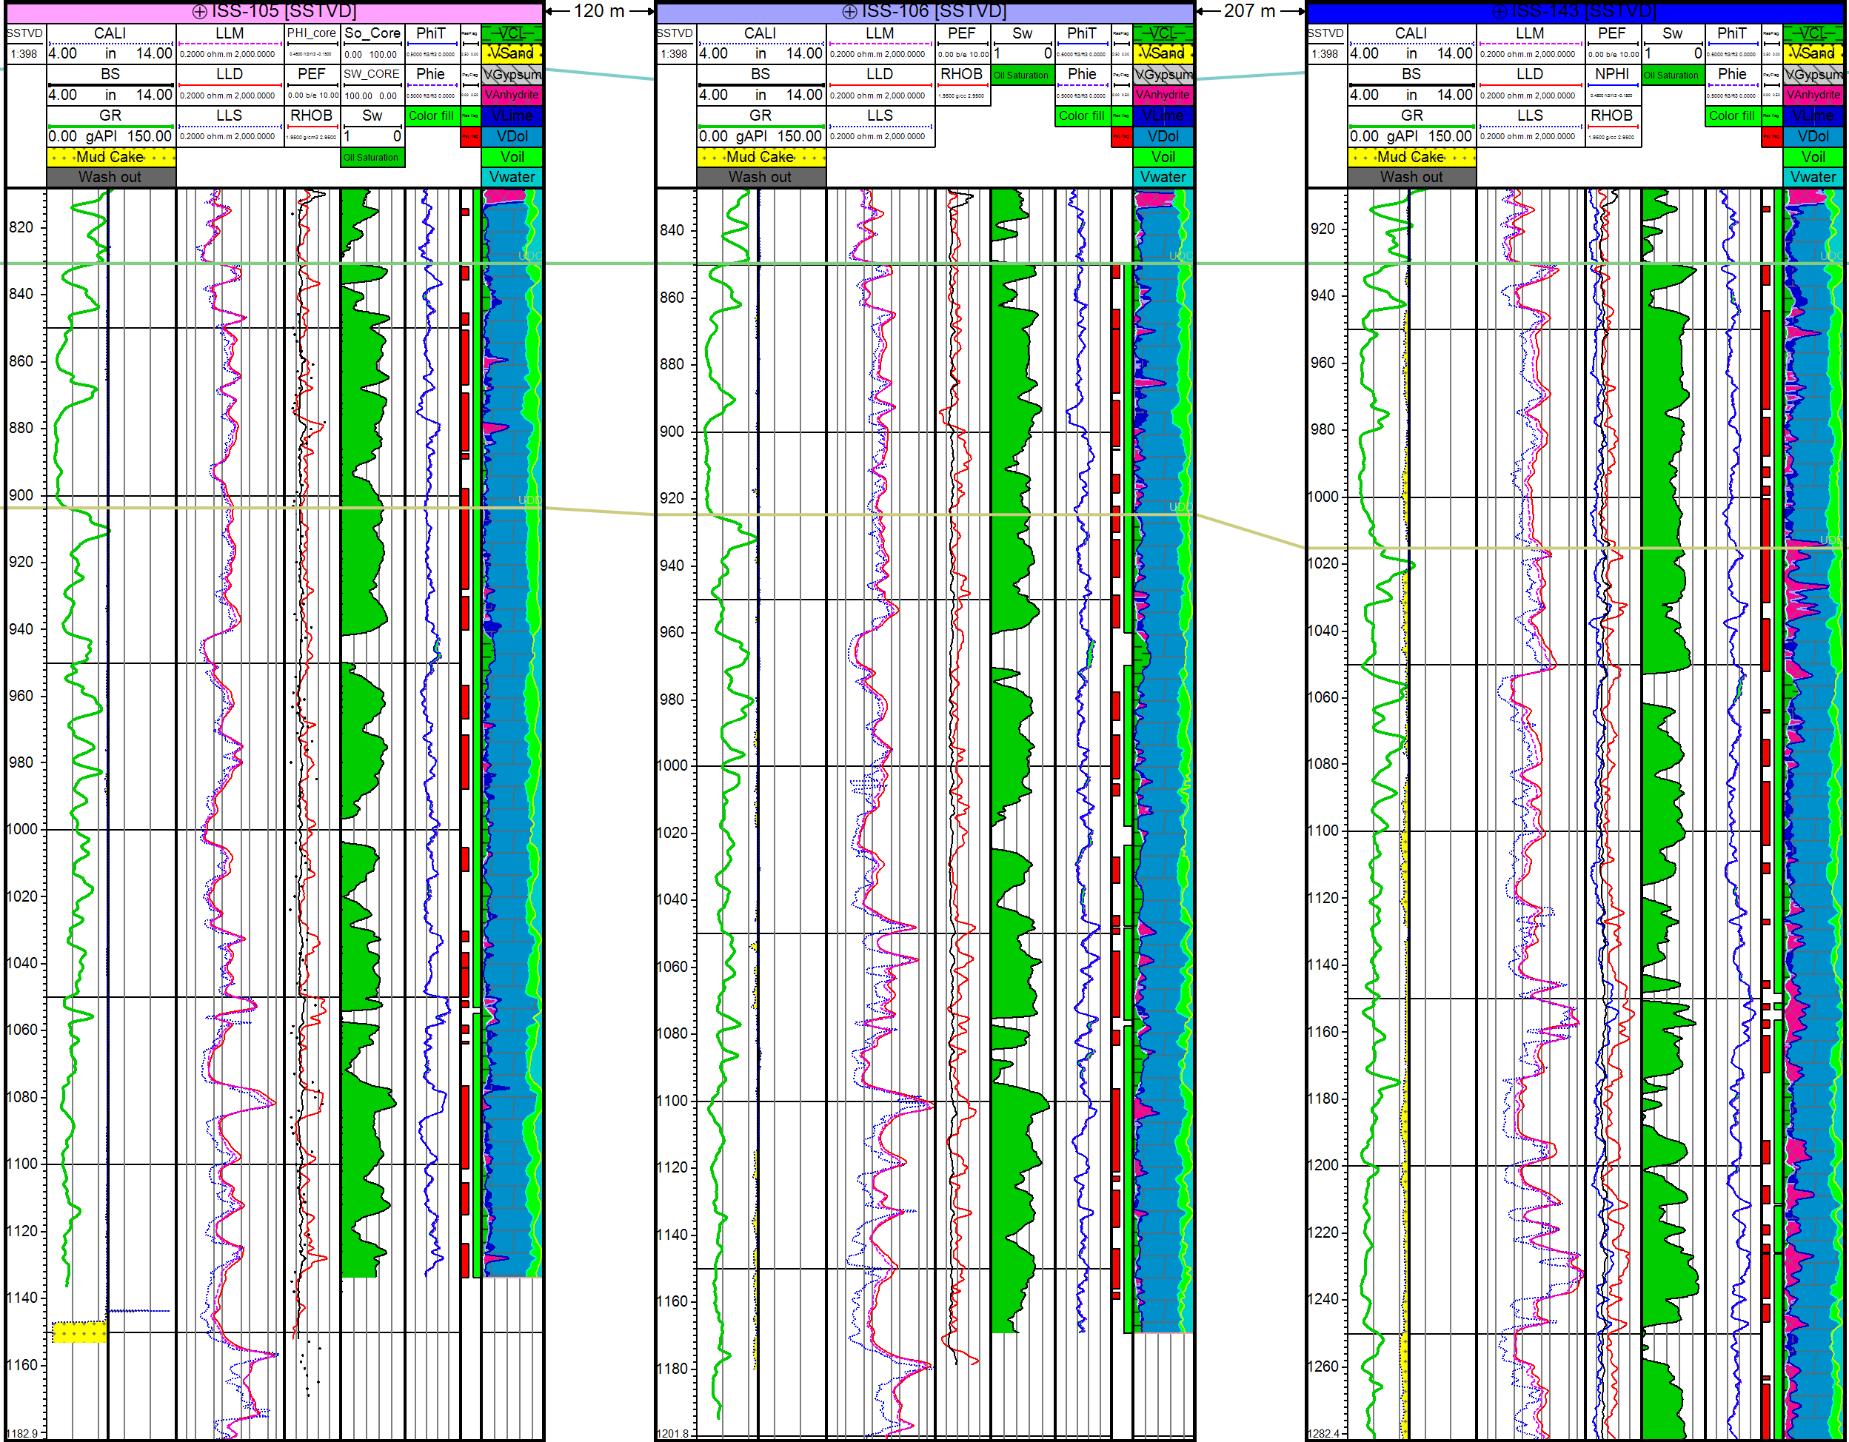
Issaran Identified Themes – High Resolution Flow unit Identification
Enhanced Oil Recovery means injecting money into the reservoir (Hi P gas, polymers or steam)
Understanding baffles and barriers is key for well design (horizontal vs deviated or vertical as well as Steam WRM
UDC
Flow Unit-01
UDD
Flow Unit-02

Slide 8
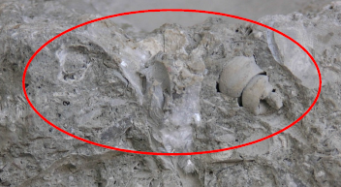
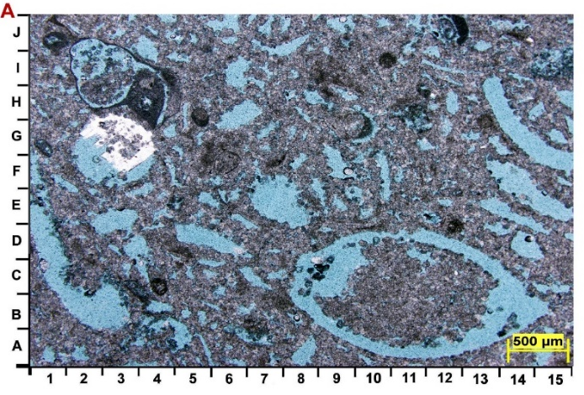
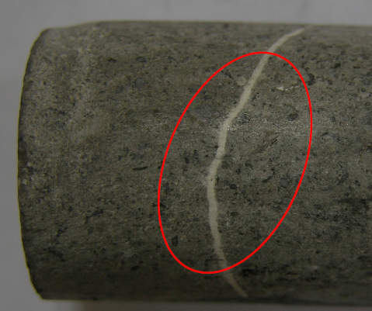
Issaran Identified Themes – Diagenetic Heterogeneity
In carbonate reservoirs, the original depositional architecture can be overprinted by later diagenetic effects.
Cementation, dissolution, compaction, dolomitization and fracturing are normal diagenetic impacts in carbonate reservoirs.
It can completely modify the depositional K/PHI properties.
Fossils replacement by Dolomite and-or Anhydrite
Dissolution of fossils high porosity
And no change in permeability
Fractures filled with minerals

Slide 9
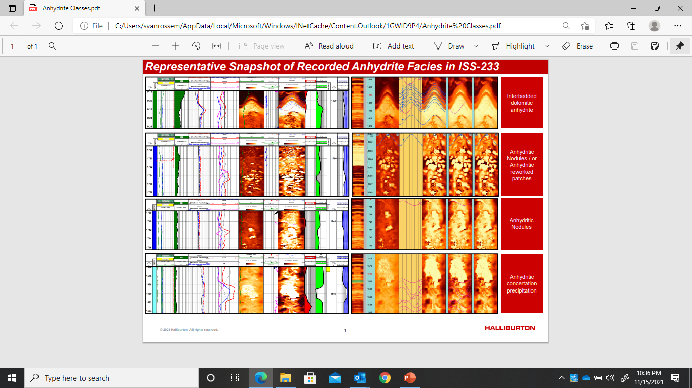
Issaran Identified Themes – Diagenetic Heterogeneity
AFR taken in every well is key
Niche expertise in HLB Cairo great help

Slide 10
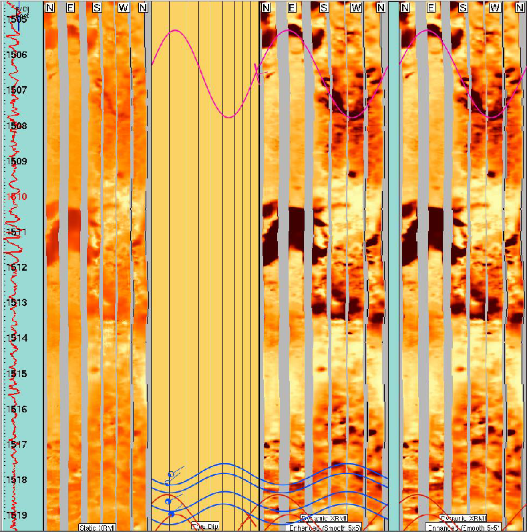
Issaran Identified Themes – Diagenetic Heterogeneity
The heterogeneity is driven by diagenetic and depositional processes
It creates a triple heterogeneity in the Issaran Upper Dolomite:
    Matrix porosity
    Fracture porosity
    Vuggy porosity
Dissolution and mineralization filled fracture
2 ft
Dissolution
Vugs “ 2-3 ft.”
Disseminated Dissolution
Vugs “ 0.1 ft.”
Image log acquisition is essential
No Acid no steam this well produced 150bopd May-Aug

Slide 11
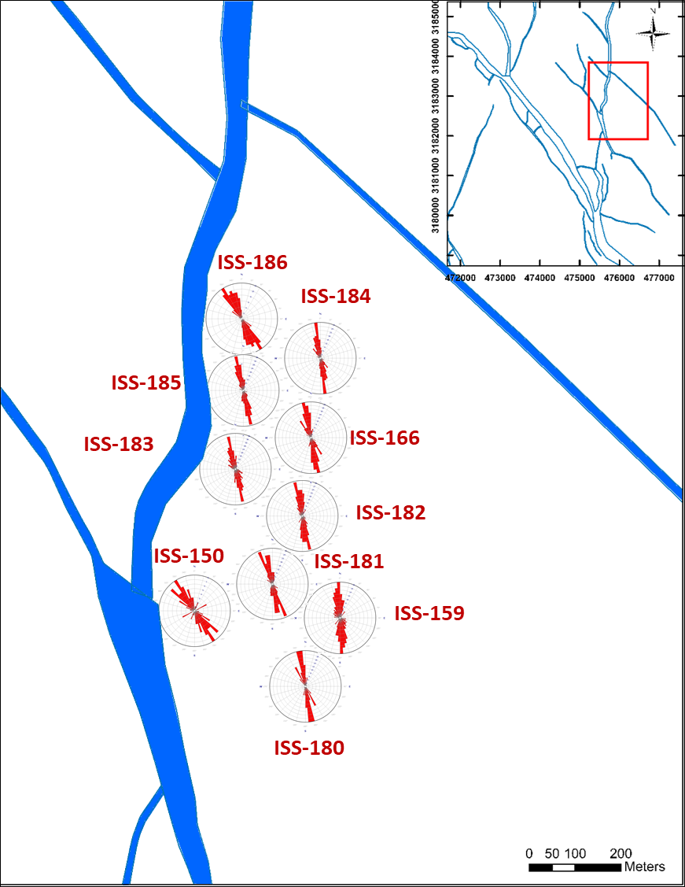
Issaran Identified Themes – Fracture Modelling
Upper Dolomite Block G
Consistent image log data acquisition and interpretation
Integrate structural model with fracture data
Develop a model for the nature of the fractures and variability over the field
Extrapolate the fracture system into the inter-well area

Slide 12
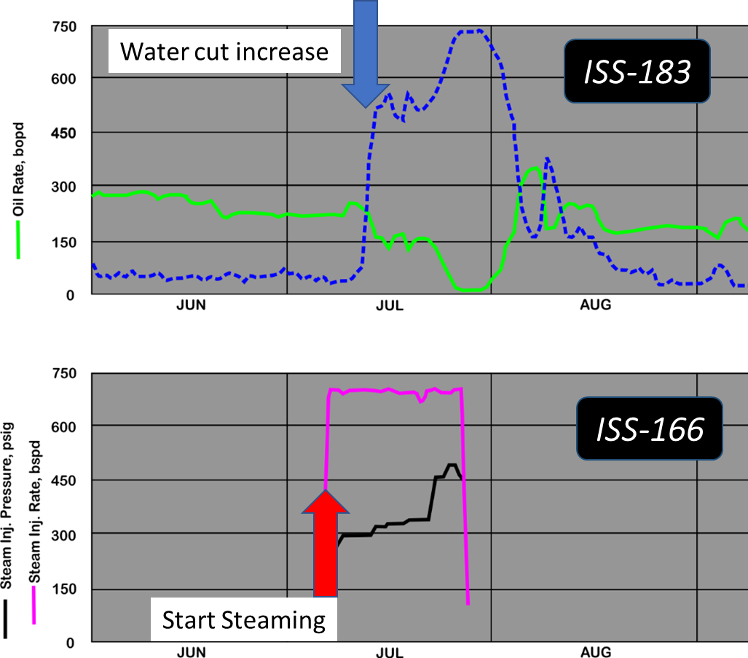
Issaran Identified Themes – Fracture Modelling
Upper Dolomite Block G
Nearby Production well
Well on Steam
With 4 days response
Group steam strategy

Slide 13
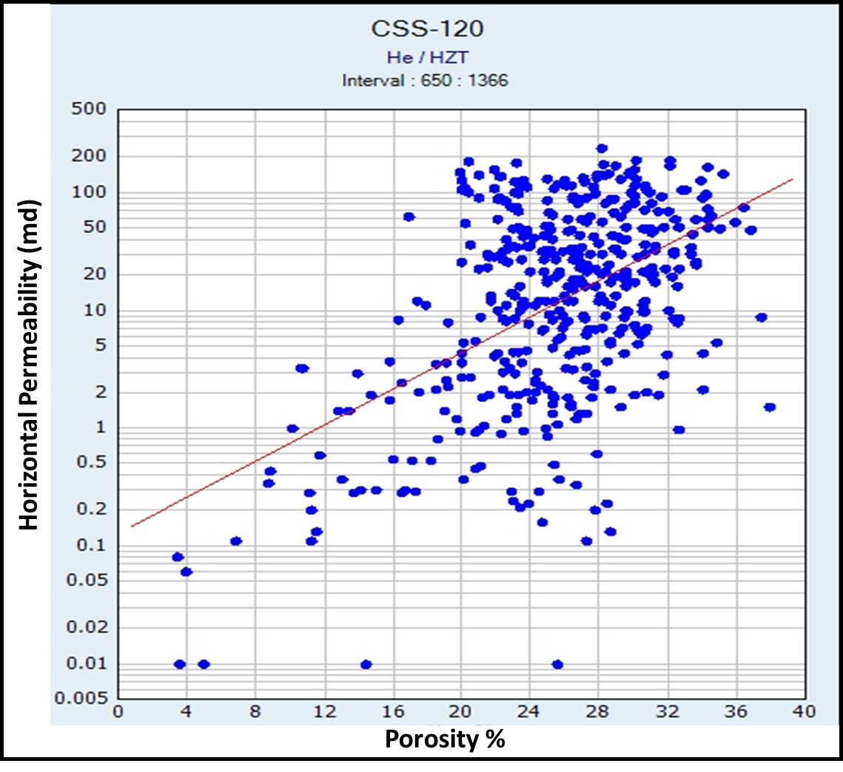
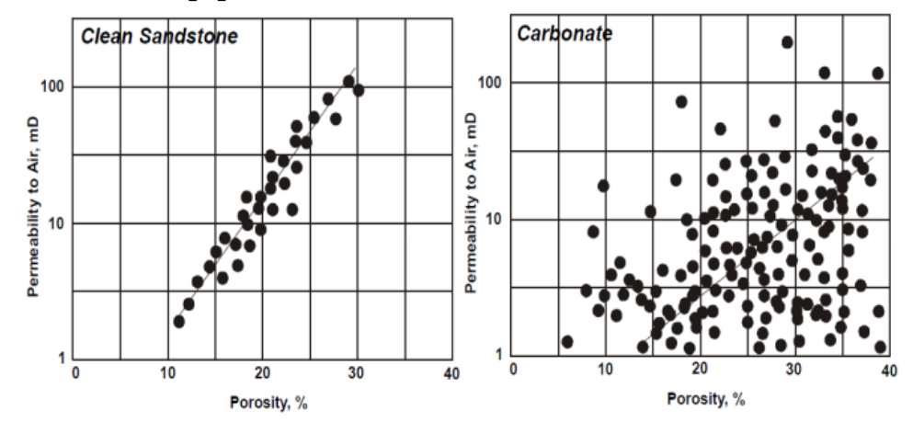
Issaran Identified Themes – Petrophysical Complexity
Clastic systems in general have reasonable poro-perm relationships.
In carbonates there is often little or no relationship between porosity and permeability.
The underlying reason is pore size distribution, which can vary over very short distances in carbonates owing to the irregularity of pore shapes.
Typical poro-perm relationship in clean sandstone and carbonates
From: Arwini 2020
Interwell prediction
Rate, Oil charge and OWC

Slide 14
Issaran Identified Themes – new technology implementation
Heavy Oil
Carbonate Reservoir
Fractured Reservoir
Steam EOR
Identify
Select
Define
Execute
Hzl
Drilling
w/ Frac
Anhy
Dissolver
Microseismic
Frac Maps
Electric
DH Heaters
CSI
GCCS
CSS
Water
Pumpoff
Foam
Steam
GOGD
TA-GOGD
USRD
ESPCP
Acid Frac/
HF Pilot
Cement
Remedial
BFD
(Bio)
Anhydrite
from Inversion
Isolation
Packer
AICVs
Gas/Heat
Solvent
GHG
Monitor
14

Slide 15
Conclusions
Theme based approach to tackle Carbonate Reservoir Complexity is essential to provide focus
Clear Technical and commercial objectives need to be defined for each study theme
    Reduce subsurface uncertainty by improved flow unit definition
    Optimise recovery from Upper and Lower Dolomite Reservoirs
      Improve modelling of permeability in carbonates
      To establish HiRes architecture of carbonate reservoirs in terms of flow paths and barriers
      Relate seismic response to reservoir quality
      Make a step-change in well productivity through piloting new Technology
𓏙 𓇋𓄿𓎡𓏲𓀘𓈉 𓎯𓏪
Stone that give Oil

